Slide 1
Database Design and Development
Topic 4:
Data Retrieval (1)
Notes:
NCC Education - Title Master

Slide 2
Scope and Coverage
This topic will cover:
  Table and view structure in a relational database
  Data types
  Null values
  Retrieving data using SQL
Notes:
NCC Education - Slide Master

Slide 3
Learning Outcomes
By the end of this topic students will be able to:
  Implement more complex relationships
  Describe how to retrieve data from one or more tables using SQL
  Recognise and identify different data-types in SQL

Slide 4
Creating Tables from Entities (some further issues)
  Representing tables
  Representing relationships
    One-to-many relationships
    One-to-many recursive relationships
    One-to-one relationships

Slide 5
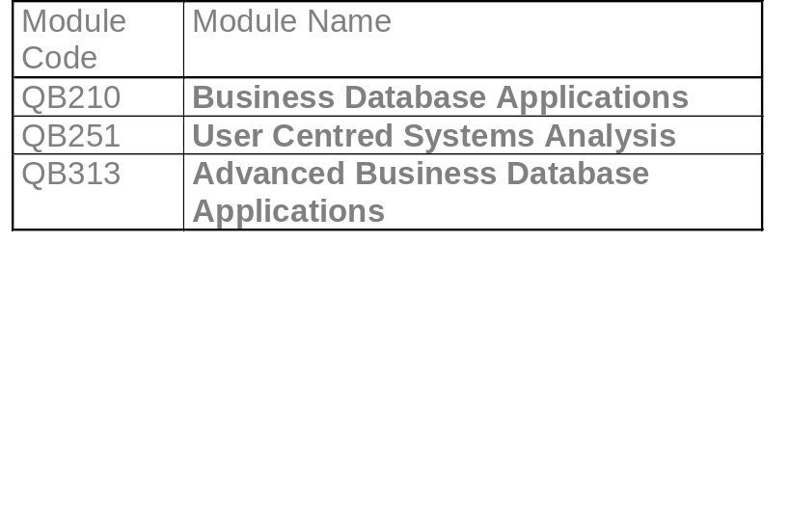
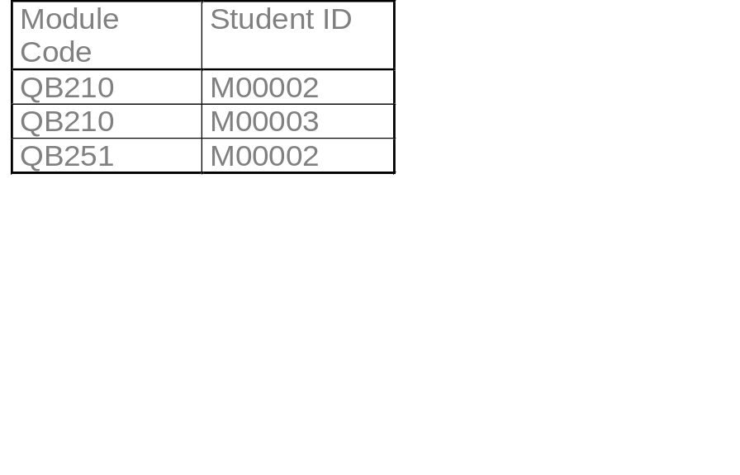
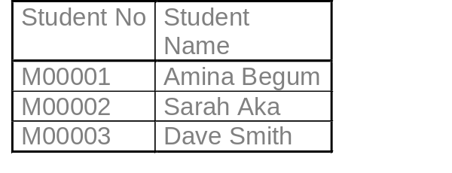
One-to-Many Relationship
Module
Attributes:
Module Code(PK)
Module Name
1
0...*
Student on
Module
Attributes
Module Code (FK)
Student No (FK)
0...*
1
Attributes:
Student No(PK)
Student Name
Student

Slide 6
One-to-Many Recursive Relationship - 1
A student is a mentor to
potentially many other
students.
0...*
Student
1
StudentID | Surname | FirstName | MentorID
22 | Smith | Dave
55 | Singh | Jagpal | 22
76 | May | Emily | 22

Slide 7
One-to-Many Recursive Relationship - 2
A student is a mentor
potentially many other
students.
Dave Smith is a mentor to two other students
StudentID | Surname | FirstName | MentorID
22 | Smith | Dave
55 | Singh | Jagpal | 22
76 | May | Emily | 22
Student (StudentID, Surname, FirstName, MentorID)
Primary Key StudentID
Foreign Key MentorID references Student(StudentID)

Slide 8
One-to-One Relationship
Student
Portfolio
1
1
Mandatory on both sides
Mandatory on one side
Optional on both sides

Slide 9
Mandatory on Both Sides
Student (StudentID, Surname, FirstName, MentorID, PortfolioID, PortfolioDate, PortfolioGrade)
The attributes belonging to the portfolio are in bold.

Slide 10
Mandatory on one Side of 1:1
  Entity that has optional participation is designated parent entity.
  Student (StudentID, Surname, FirstName, MentorID, PortfolioID)
  Portfolio(PortfolioID, PortfolioDate, PortfolioGrade)

Slide 11
Optional on Both Sides
  Arbitrary. Depends on semantics.
Student
Studio
1
1
A student may have the use of a single student. A studio might be used by a single student. Where does the FK go?

Slide 12
Objectives of SQL
  Create the database and relation structures
  Perform basic tasks such as inserts, updates and deletes
  Simple and complex queries
Structured Query Language

Slide 13
Data Definition Language DDL
  For defining database structures and controlling access to data
    CREATE TABLE, CREATE INDEX , CREATE SEQUENCE , GRANT ACCESS etc.
  Data Manipulation Language DML
    For retrieving and updating data
      SEECT, INSERT, UPDATE, DELETE

Slide 14
Data Manipulation Language DML
  For retrieving and updating data
  SELECT
  INSERT
  UPDATE
  DELETE

Slide 15
  Select branchID, Count(staff_id)
  From workers
  Where branchType = ‘Main’
  Group by branchID
  Having Count (staff_id) > 1
  Order by branchID

Slide 16
What columns will appear
  Select branchID, Count(staff_id)
  From workers
  Where branchType = ‘Main’
  Group by branchID
  Having Count (staff_id) > 1
  Order by branchID
Which table
Condition
Groups by some column
Value
Restricts what will
Be grouped
Specifies the order of the result

Slide 17
Literals
  Insert into Student (Stu_id, First_name, Last_name)
  Values (1,’Satpal’,’Singh’);
Non-numeric in single quotes.
Numeric NOT in quotes

Slide 18
Select
  SELECT first_name
  FROM Students
  WHERE Student_type = ‘Overseas’;

Slide 19
All the Columns or some of them
  Select *
  from Students
  Where student_type = ‘Overseas’;
  Select student_id, first_name, last_name,
  From Students
  Where student_type = ‘Overseas’;

Slide 20
Order by
  Select first_name, last_name, stu_id
  From Students
  Where student_type = ‘Overseas’
  Order by last_name;

Slide 21
Order by
  Select first_name, last_name, stu_id
  From Students
  Where student_type = ‘Overseas’
  Order by last_name desc;

Slide 22
Aggregate Functions - 1
  Count
  Sum
  Avg
  Min
  Max

Slide 23
Aggregate Functions - 2
  Count – returns number of values in a column
  Sum – returns the sum total of values of a column
  Avg – returns the mean average of values in column
  Min – returns the lowest value in a column
  Max – returns the highest value in a column

Slide 24
Example of Aggregate Function
  Select branchID, Count(staff_id)
  From workers
  Where branchType = ‘Main’
  Group by branchID
  Having Count (staff_id) > 1
  Order by branchID
  This counts the number of members of staff in main branches where there are more than 1 staff. It groups them by the branchID.

Slide 25
Group By
  As shown in the previous slide...
  This clause is used with an aggregate function and groups the results by some attribute

Slide 26
Having Clause
  Modifies the group by clause
    Select branchID, Count(staff_id)
    From workers
    Where branchType = ‘Main’
    Group by branchID
    Having Count (staff_id) > 1
    Order by branchID
  In this case only selecting groups where it has been calculated by the count function that there are more than one member of staff.

Slide 27
Sub-Queries
  Select d.department_name, d.location
  From departments d, workers w
  Where d.dept_no = w.dept_no
  And w.age =
  (select max(w2.age)
  From workers w2);

Slide 28
Joins
  Select d.department_name, w.first_name, w.last_name
  From departments d, workers w
  Where d.dept_no = w.dept_no;

Slide 29
Fixing Errors
  Not specifying join condition properly
  Syntax errors
  Spelling errors for keywords
  Columns not existing on tables
  Data-types being mixed up

Slide 30
Datatypes
  What is a datatype?
  What is a domain?

Slide 31
String Datatypes
  Character or Char
  Varying Character of Varchar
  Bit (N)

Slide 32
Char or Varchar
  ‘Gary__’ a 6 long Char
  ‘Gary’ a 6 long varchar

Slide 33
Numeric Datatypes
  Numeric or Decimal e.g. 8.23 with point set
  Integer e.g. 8
  Float e.g. 8.23 but could also be changed so that point moves when needed

Slide 34
Datetime Types
  Date
  Time
  Timestamp
  Interval

Slide 35
Null Values
  What are null values?
  Activity: think of all the different things that null could represent.

Slide 36
Learning Outcomes
By the end of this topic students will be able to:
  Implement more complex relationships
  Describe how to retrieve data from one or more tables using SQL
  Recognise and identify different data-types in SQL

Slide 37
References
  Connolly, T. and Begg, C. (2004) Database Solutions: A step-by-step guide to building database, 2nd Edition Addison-Wesley - Chapters 9 and 10
  Connolly, T. and Begg, C. (2004). Database Systems: A Practical Approach to Design, Implementation, and Management, 4th Edition. Addison Wesley - Chapters 5, 6 and 7
  Benyon-Davies, P. (2003). Database Systems, 3rd Revised Edition. Palgrave Macmillan – Chapters 11, 12 and 13
  Dietrich, Suzanne W, (2001) Understanding Relational Database Query Languages - Chapter 5

Slide 38
Topic 4 – Data Retrieval (1)
Any Questions?
Notes:
NCC Education - End Slide Master

